Slide 1
Smart Agriculture System based on IOT
Name : Polu Tharun Kumar Reddy
Internship : Smart Agriculture System based on IOT – SB33154

Slide 2
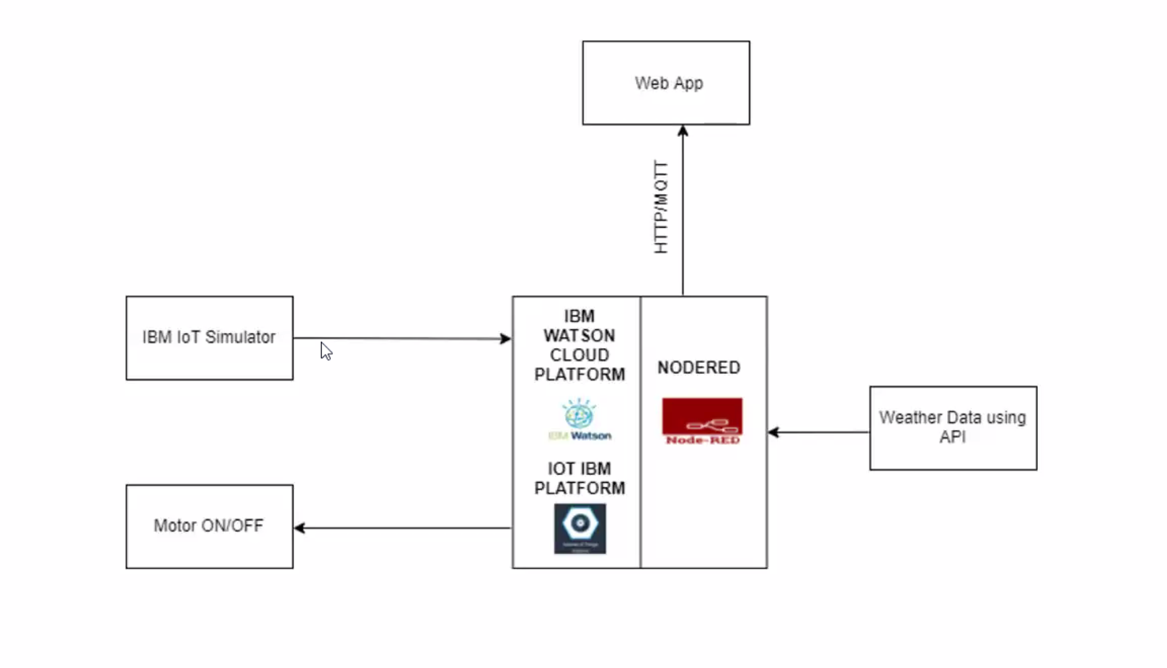
Block DIAGRAM

Slide 3
Project description
Smart agriculture system based on IOT can monitor soil moisture and climatic conditions to grow and yield a good crop
The farmer can also get the real time weather forecasting data by using external platforms like Open Weather API.
Farmer is provided a mobile app using which he can monitor the temperature ,humidity and soil moisture parameters along with weather forecasting details.
Based on all the parameters he can water his crop by controlling the motors using the mobile application.
Even if the farmer is not present near his crop he can water his crop by controlling the motors using the mobile from anywhere.

Slide 4
ADVANTAGES & DISADVANTAGES
ADVANTAGES:
Small sized farmers support team is enough as only a low volume of queries are redirected.
Cost efficient.
Only a small amount of queries need representatives ,hence the customer is also satisfied with quick and easy solution.
DISADVANTAGES:
The IBM Watson Discovery service returns wrong results if not properly configured
Same answers might be given for different queries

Slide 5
applications
Using the IoT concept in agriculture field will help farmers not only to reduce waste but also to increase in yield production.
These days IoT has also been implemented in these following practices:
a. Crop Monitoring
b. Precision Farming
c. Livestock Monitoring
d. Agricultural Drones

